Slide 1
Module 4: Azure Machine Datasets and Datastore

Slide 2
Data Science Building Blocks Project
Prepare data, train models
Hyperparameter tuning
Experimentation and pipelines
Deployment
Monitor and Retrain
Classical ML
Deep learning
Data
Data stores
Data sets
Managed Compute
Azure Machine Learning compute cluster

Slide 3
Data Science Building Blocks Project
Prepare data, train models
Hyperparameter tuning
Experimentation and pipelines
Deployment
Monitor and Retrain
Classical ML
Deep learning
Data
Data stores
Data sets
Managed Compute
Azure Machine Learning compute cluster

Slide 4
Data Science Building Blocks Project
Prepare data, train models
Hyperparameter tuning
Experimentation and pipelines
Deployment
Monitor and Retrain
Classical ML
Deep learning
Data
Data stores
Data sets
Managed Compute
Azure Machine Learning compute cluster

Slide 5
Data Science Building Blocks Project
Prepare data, train models
Hyperparameter tuning
Experimentation and pipelines
Deployment
Monitor and Retrain
Classical ML
Deep learning
Data
Data stores
Data sets
Managed Compute
Azure Machine Learning compute cluster

Slide 6
Datastores
Provide an interface to the different storage types in Azure.
Abstracts away connection details for the data scientist.
Datastores are available for most storage types in Azure:
Azure Storage
Azure SQL
Azure Data Lake

Slide 7
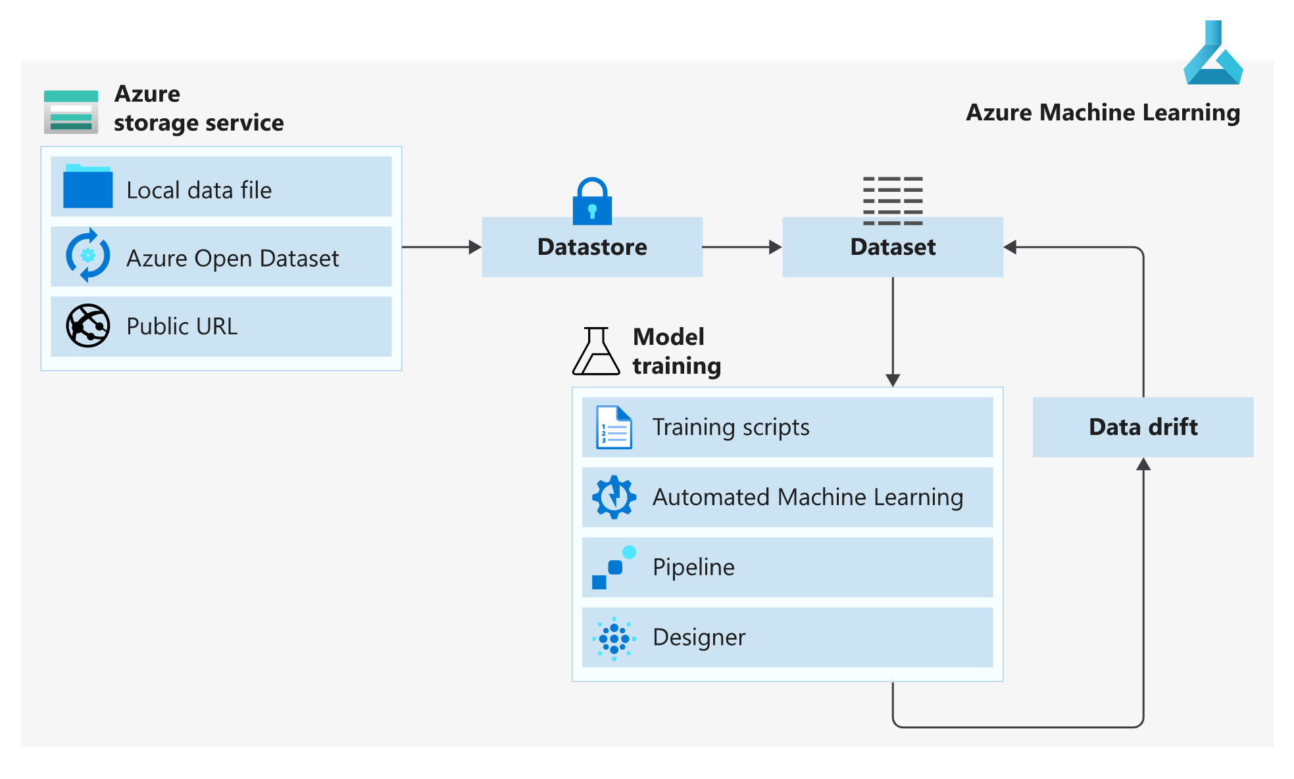

Slide 8
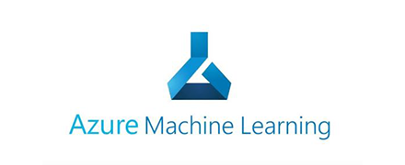
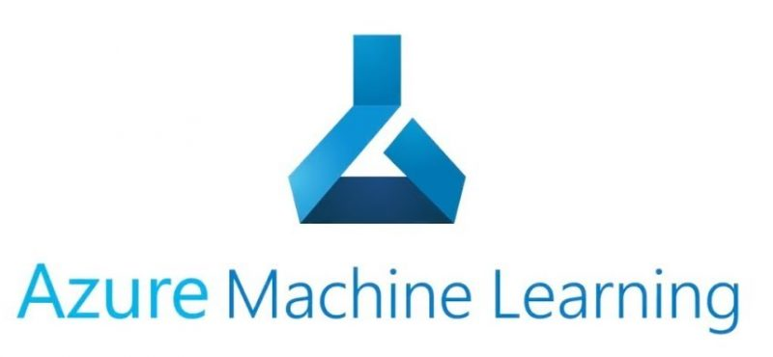
train.py
Conda_dependencies.yml
Azure Managed Compute
Subset data
Training script
Data sets
Environment
Compute
train_sumit.py
Hyperdrive Run configuration
Search grid
logs
Experiment
Submit run
Parent run
Child runs

